Slide 2
Features
Component Based Approach
Lazy Loading (Flexible Routing)
Better Performance
Dependency Injection
Usage of Typescript
Mobile Driven
Testable

Slide 3
Typescript
Super Set of JavaScript
Type Safety Checks
Supports Inheritance and Interfaces
Transpile to JavaScript

Slide 4
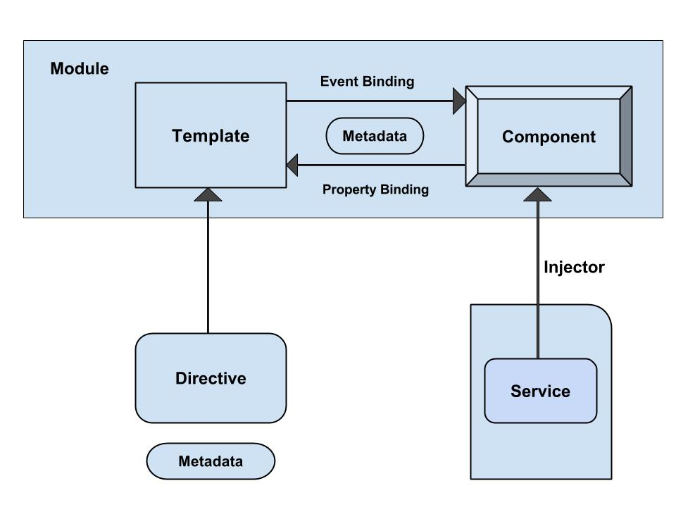
Architecture

Slide 5
Bootstrap and Demo

Slide 6
Lifecycle Hooks
ngOnChanges
ngOnInit
ngOndestroy
ngAfterViewInit
ngAfterContentInit
ngAfterContentChecked
ngAfterViewChecked

Slide 7
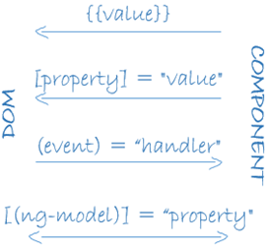
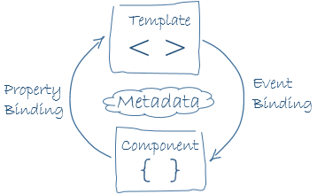
Data Binding

Slide 8
Data Binding
Data Direction | Syntax | Binding Type
One way from data source to view target | {{expression}} [target] = "expression" | Interpolation Property Attribute Class Style
One way from view target to data source | (target) = "expression" | Event
Two way | [(target)] = "expr" | Two-way

Slide 9
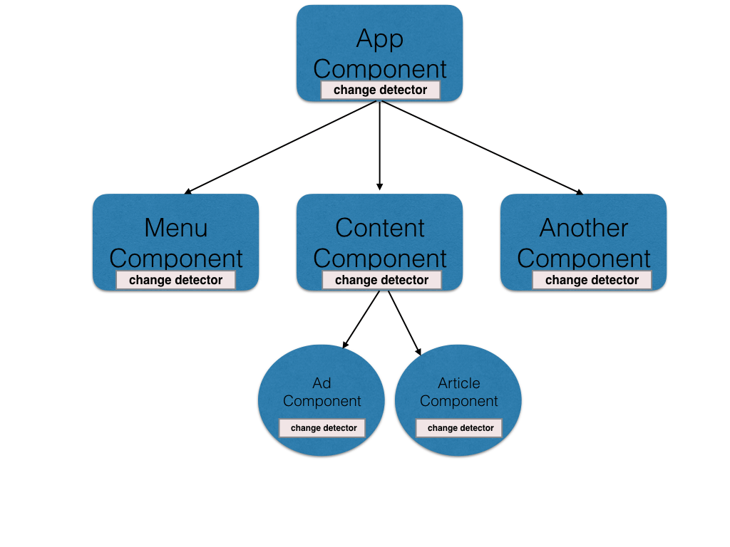
Change Detection
Checks for changes in the data model so that it can re-render the DOM
Changes are caused by events, XHR, and timers.

Slide 10
Change Detection
ngZone for Change detection
Unidirectional Flow
Component based change detector
ChangeDetectorRef
Smarter Change Detection

Slide 11
Q&A

